Slide 1
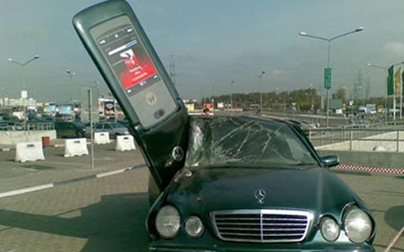
Mobile Computing
CSE 40814/60814
Spring 2018

Slide 2
Course Overview
Instructor: Christian Poellabauer
323B Cushing Hall
cpoellab@cse.nd.edu
574-631-9131
Office hours: Tue 10-11, Wed 11-12, and by appointment
TA: Ding Yukun, office hours/location TBD
Website: schedule, grading, project info, ...

Slide 3
Course Goals
Fundamentals of mobile computing
Fundamentals of wireless networking
Topics from closely related areas:
Pervasive Computing
Wearables
Internet of Things
Real-Time Systems
Embedded Systems
Wireless sensor networks
Acquire and practice development skills

Slide 4
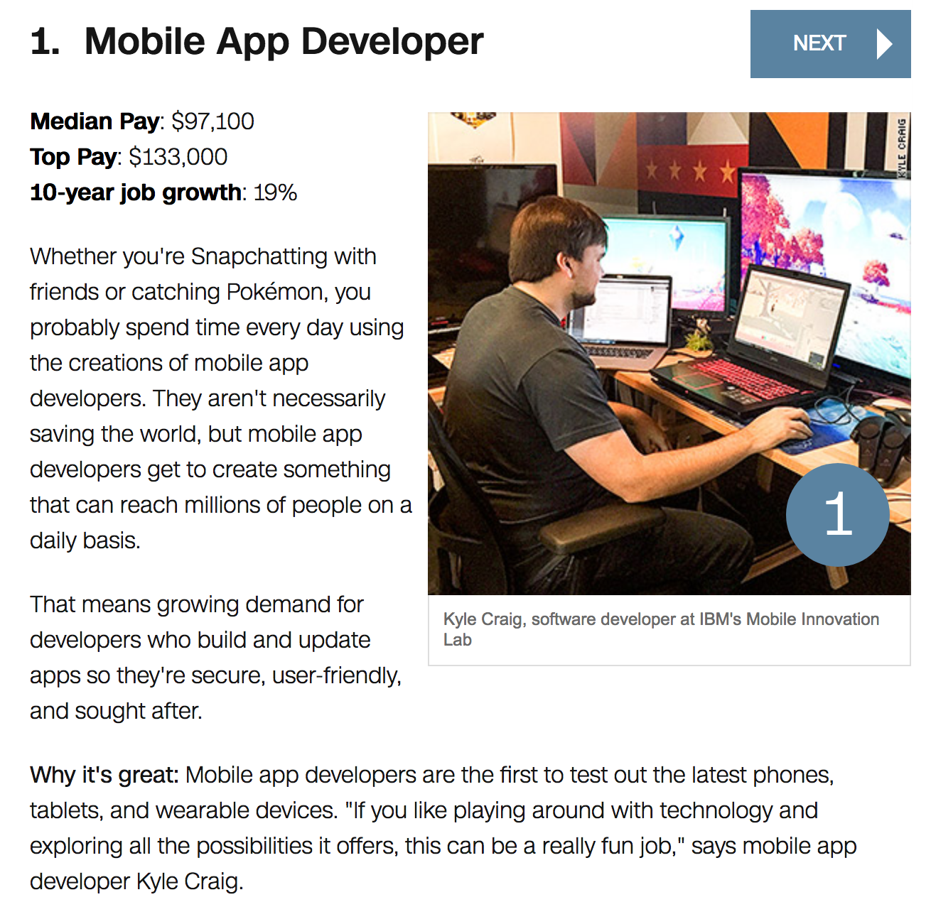
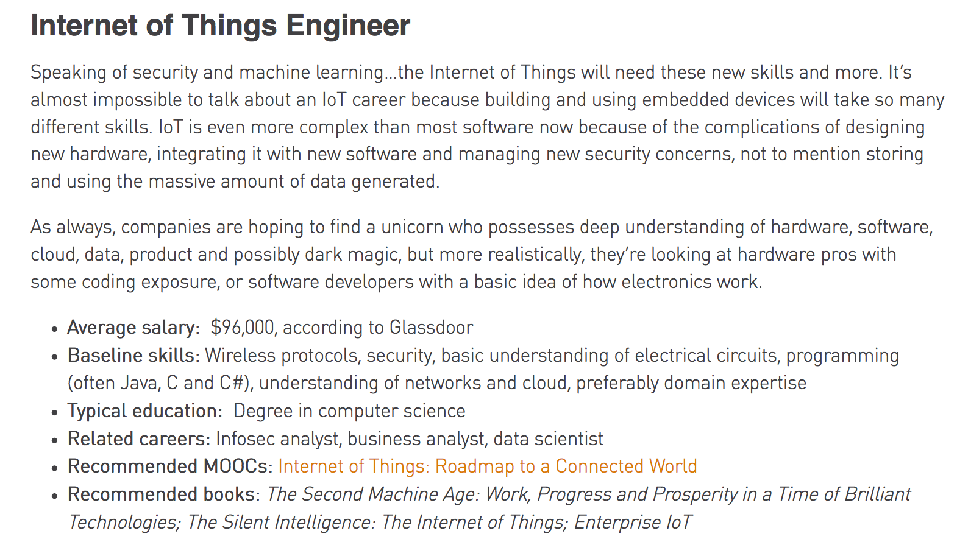
Mobile Computing & IoT Prospects
TEKsystems 2017
CNN Money 2017

Slide 5
Grading
Midterm Exam 25%
Final Exam 25%
First Progress Report 5%
Second Progress Report 5%
Starter Project Deliverables 10%
Final Project Deliverables 10%
Project Demonstration/Presentation 10%
Class Participation 10%

Slide 6
Course Project
Starter Project:
Purpose: Learn/improve skills
Individually or in teams [1-3]
Final Project
Purpose: Develop innovative/unique “mobile computing solution”
Individually or in teams [1-3]
Ideally: final project builds closely upon the starter project
If possible (but not required): propose starter project with final project already in mind
Use starter project period to identify final project topic and form team if desired
Some collaboration between teams allowed/encouraged

Slide 7
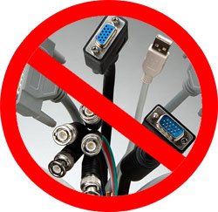
Mobile Computing
A simple definition could be: Mobile Computing is using a computer (of one kind or another) while on the move
Another definition could be: Mobile Computing is when a work process is moved from a normal fixed position to a more dynamic position
A third definition could be: Mobile Computing is when a work process is carried out somewhere where it was not previously possible
Mobile Computing is an umbrella term used to describe technologies that enable people to access services anytime and anywhere

Slide 8
Mobile Computing
Many other names/overlapping computing paradigms:
Pervasive Computing
Ubiquitous Computing
Wireless Systems
Internet of Things (IoT)
Embedded Computing
Nomadic Computing
Wireless Sensor Networks
(Mobile) Ad-Hoc Networks
Mesh Networks
Vehicular Networks
…

Slide 9
Mobile Computing
Applications
Location-awareness
Mobility Support
Security
Resource Management
Network Protocols
Broadcast
Technologies
Standards
Wireless Medium
Mobile Computing
Wireless Communication

Slide 10
Wired vs Wireless
Wired Networks
high bandwidth
low bandwidth variability
can listen on wire
high power machines
high resource machines
need physical access (security)
low delay
connected operation
Mobile Networks
low bandwidth
high bandwidth variability
hidden terminal problem
low power machines
low resource machines
need proximity
higher delay
disconnected operation

Slide 11
Why Go Mobile?
Enable anywhere/anytime connectivity
Bring computer communications to areas without pre-existing infrastructure
Enable mobility
Enable new applications
An exciting new research area

Slide 12
Evolution
Mobile computing can be categorized into seven major categories of focus
These categories are the basis for the technology that is used today in research and design of mobile computing
Each category or section is a different area that was focused on making mobile computing what it is today
These seven categories are: Portability, Miniaturization, Connectivity, Convergence, Divergence, Apps, Digital Ecosystems

Slide 13
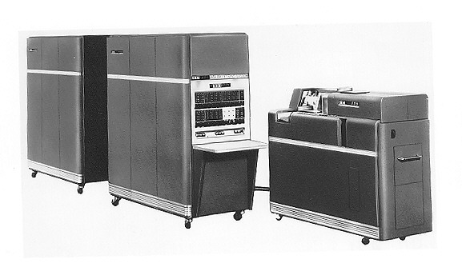
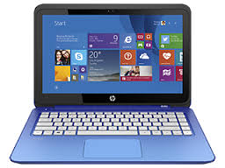
Portability
Reducing the size of hardware to enable the creation of computers that could be physically moved around relatively easily

Slide 14
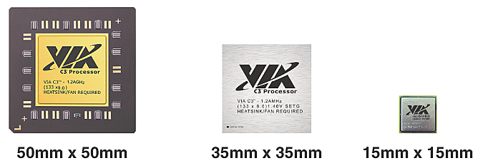
Miniaturization
Creating new and significantly smaller mobile form factors that allowed the use of personal mobile devices while on the move

Slide 15
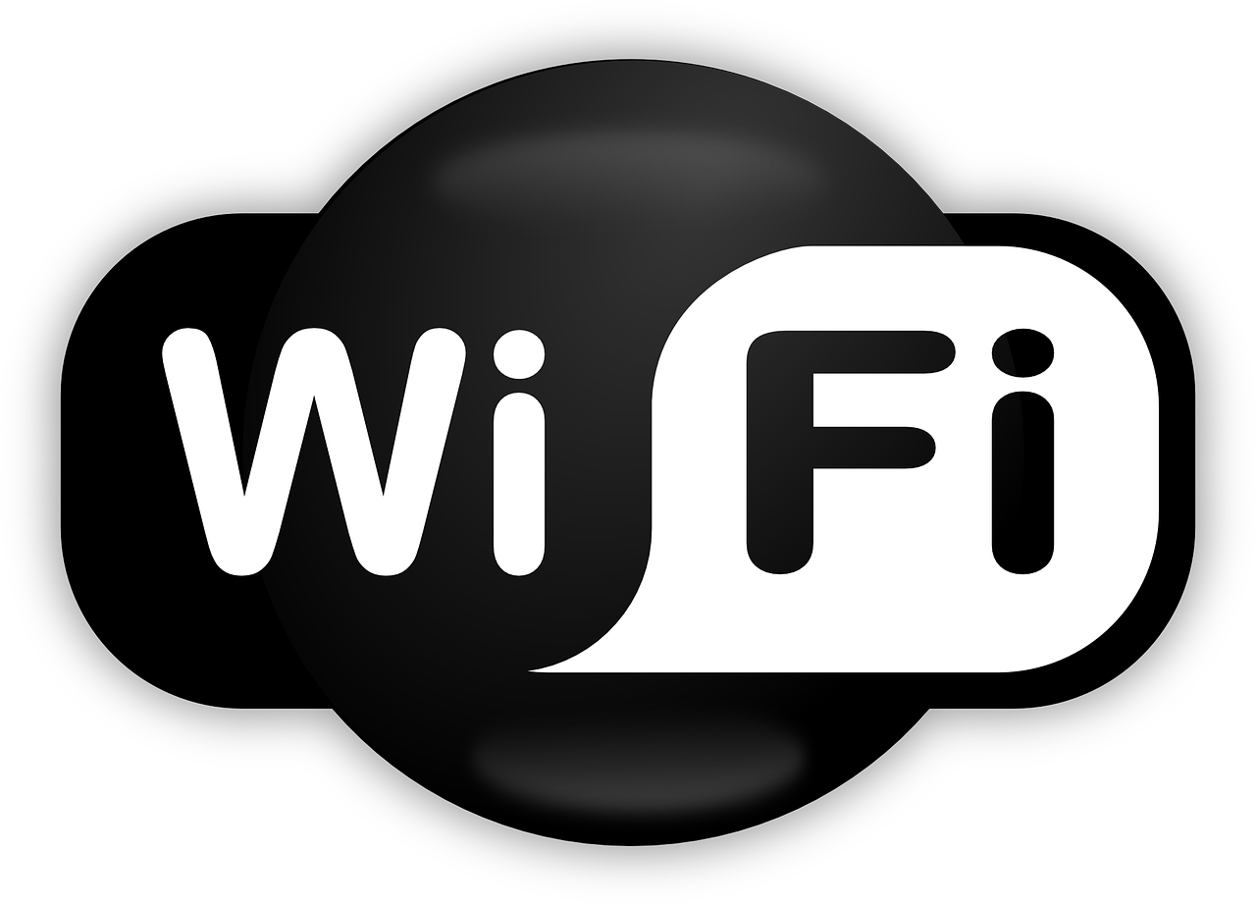
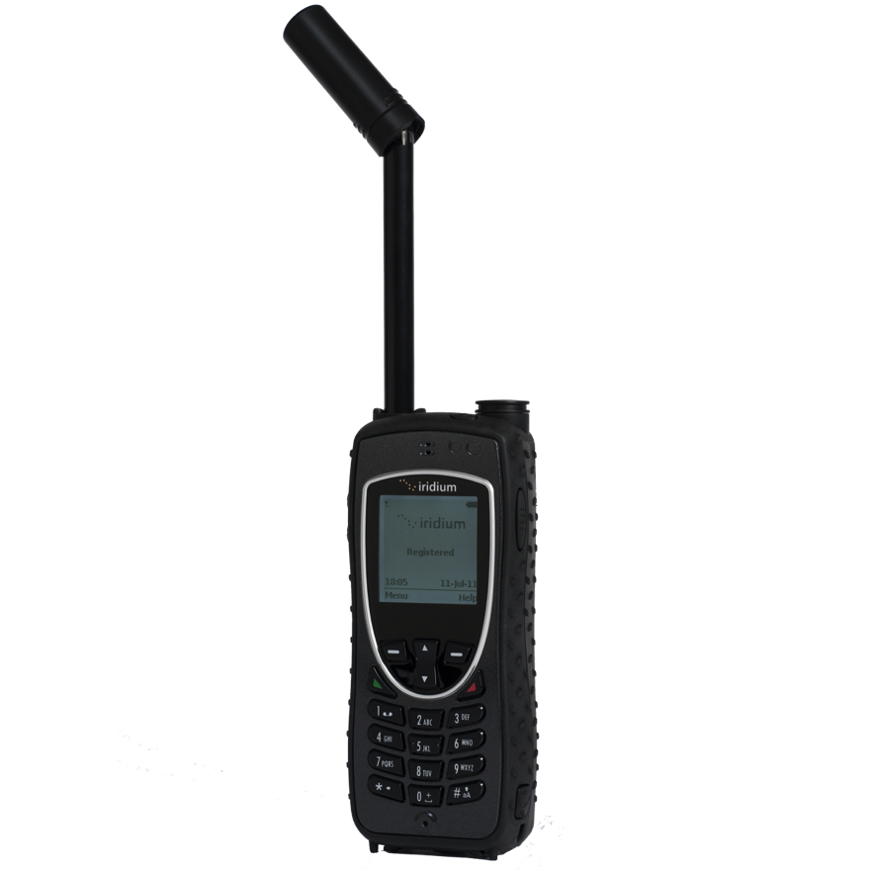

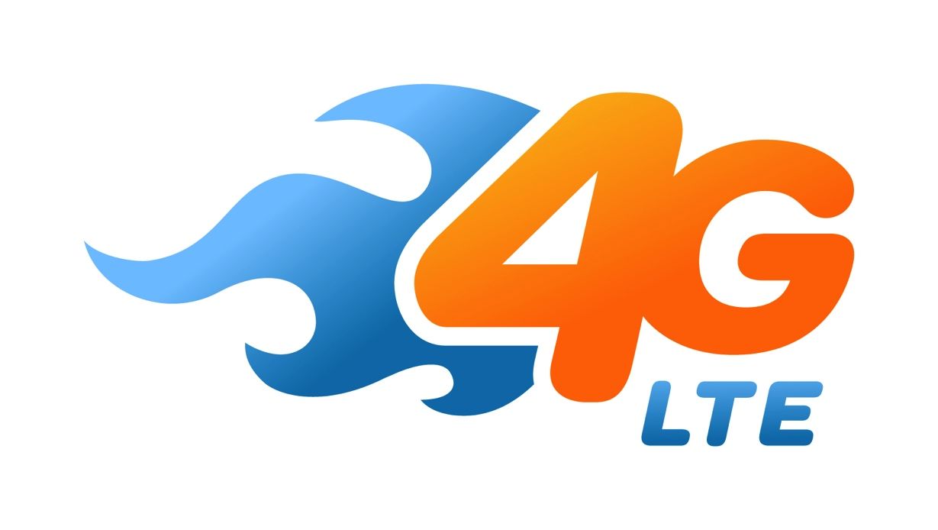
Connectivity
Developing devices and applications that allowed users to be online and communicate via wireless data networks while on the move

Slide 16
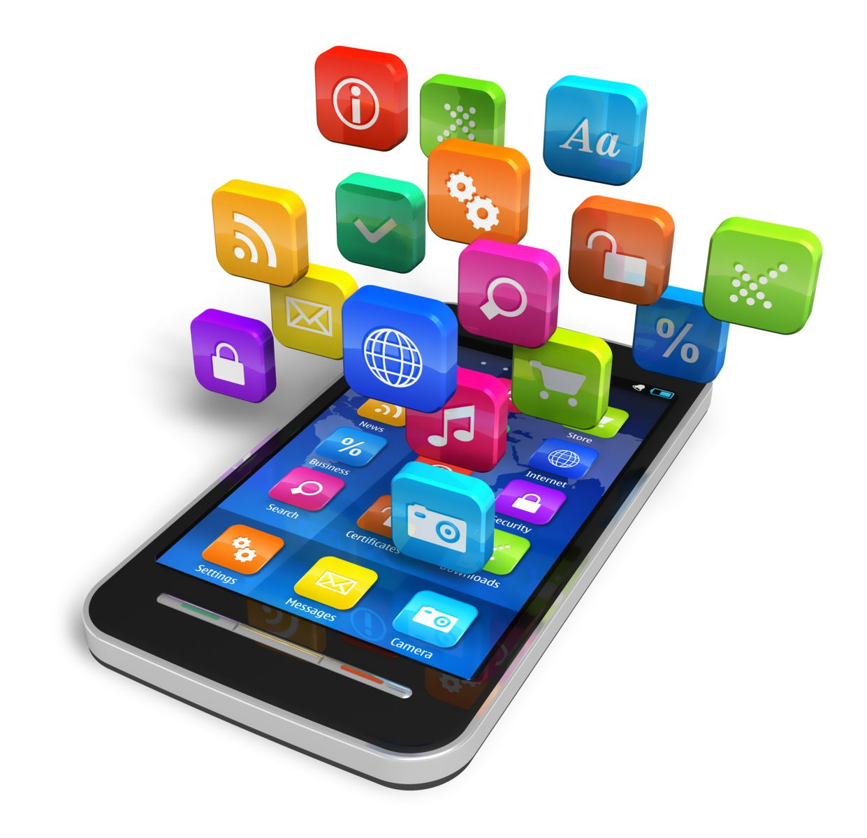
Convergence
Integrating emerging types of digital mobile devices, such as Personal Digital Assistants (PDAs), mobile phones, music players, cameras, games, etc., into hybrid devices

Slide 17
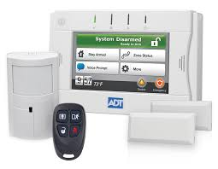
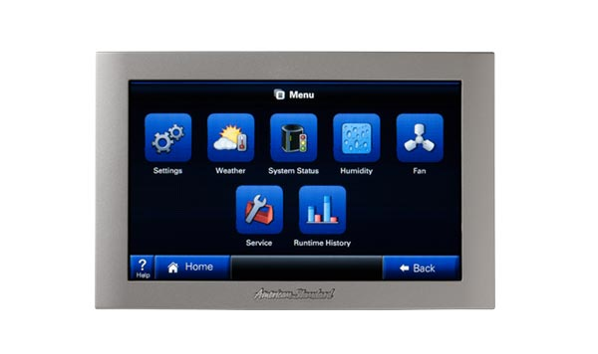
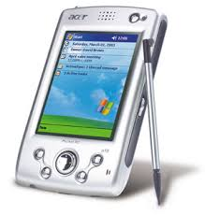
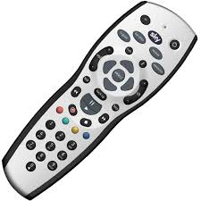
Divergence
Opposite approach to interaction design by promoting information appliances with specialized functionality rather than generalized ones

Slide 18
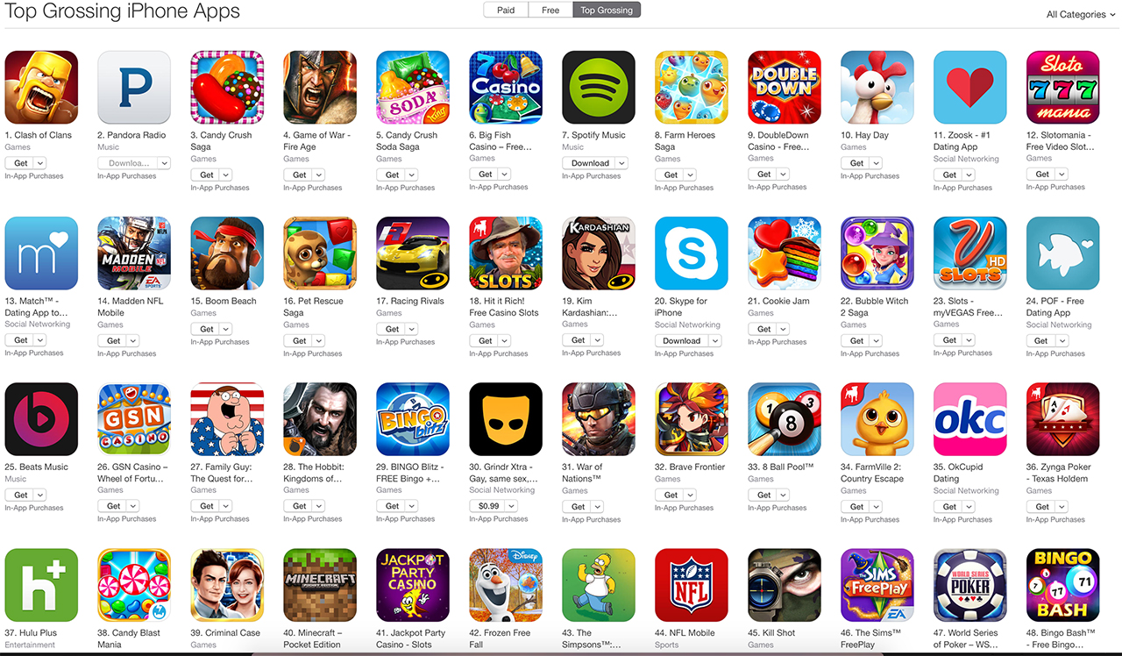
Applications (Apps)
The latest wave of applications (apps) is about developing matter and substance for use and consumption on mobile devices, and making access to this fun or functional interactive application content easy and enjoyable

Slide 19
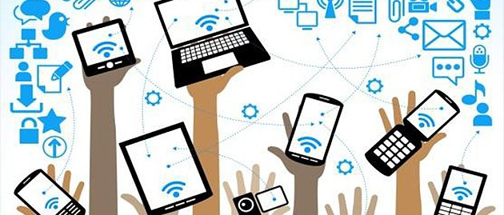
Digital Ecosystems
The emerging wave of digital ecosystems is about the larger wholes of pervasive and interrelated technologies that interactive mobile systems are increasingly becoming a part of

Slide 20
Example: Smartphone
Portability: carry it anywhere you want
Miniaturization: make it possible to build device to fit in your pocket
Connectivity: Wi-Fi, LTE/4G, cellular, Bluetooth
Convergence: phone, camera, gaming device, movie streaming, music player, …
Divergence: ?
Applications: “Rise of the Apps”
Digital Ecosystem: social networks, distributed gaming, video streaming, work apps, …

Slide 21
App Store (iOS)
2003: iTunes Music Store
2008: iPhone App Store (iPhone 3G with App Store support)
2015: > 100 billion app downloads
2016: > 2 million apps
2016: China biggest App Store market
2016: App developers earned $20 billions
Most downloaded app: Minecraft Pocket Edition (paid) and Pokemon GO (free)

Slide 22
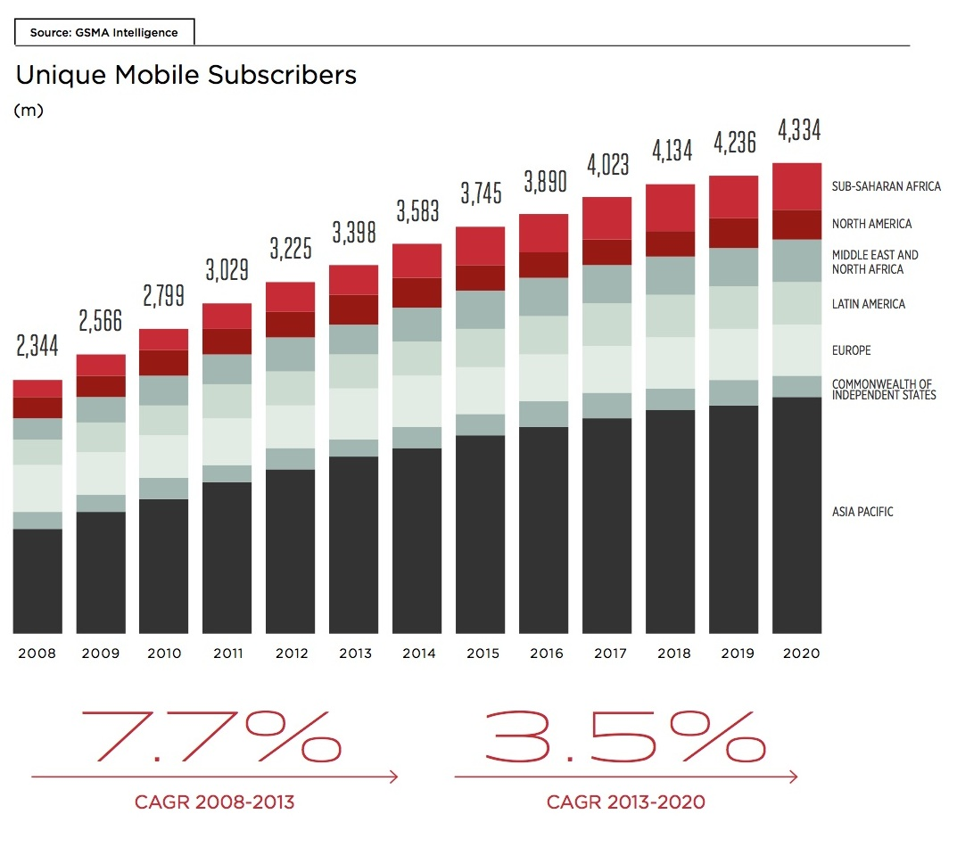
Trends in Mobile: Phone Subscribers

Slide 23
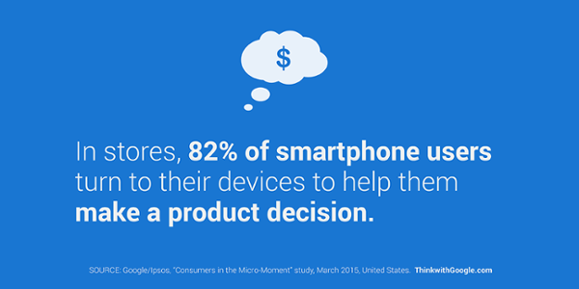
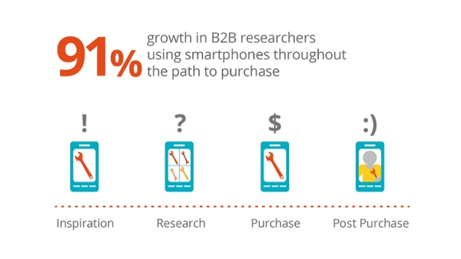
Trends in Mobile: Shopping

Slide 24
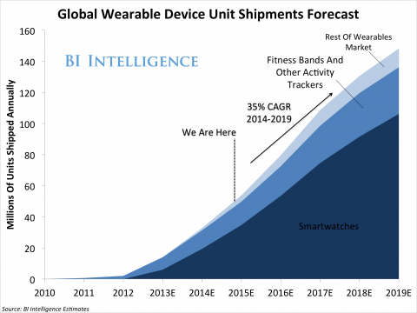
Trends in Mobile: Wearables

Slide 25
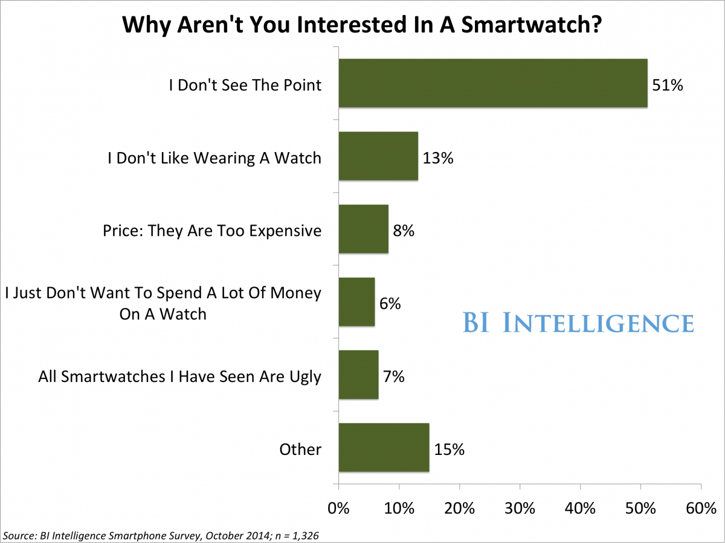
Trends in Mobile: Smartwatches

Slide 26
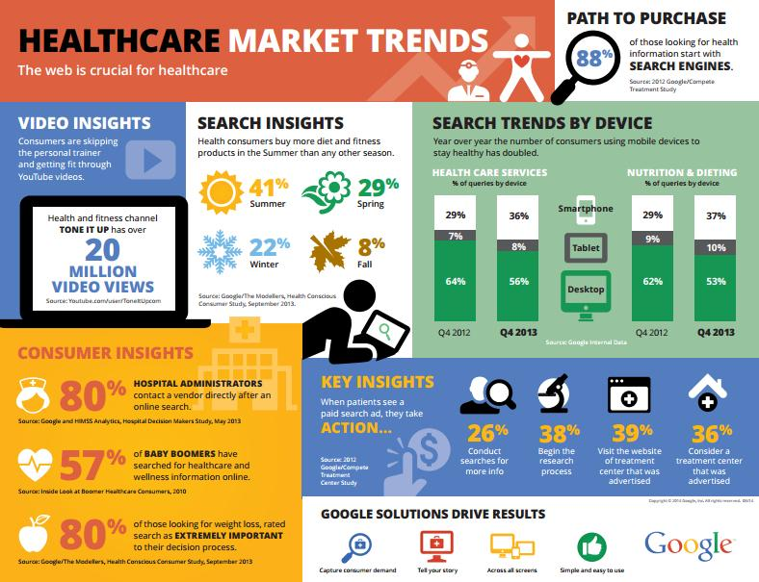
Trends in Mobile: Healthcare

Slide 27
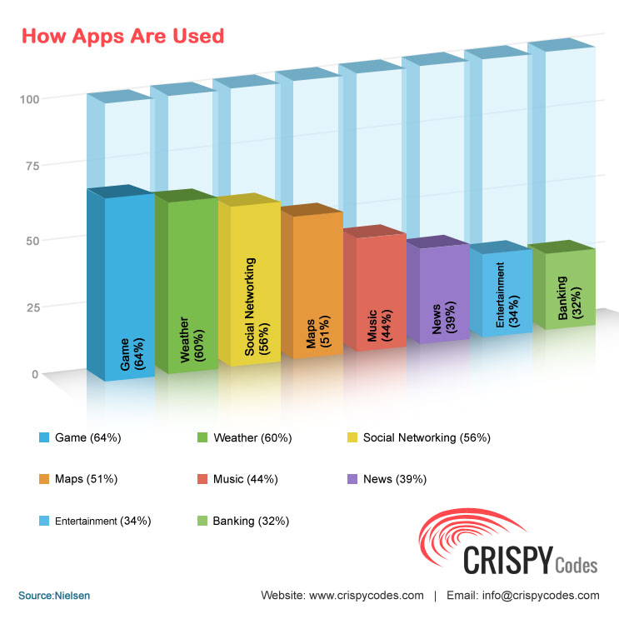
Trends in Mobile: Apps

Slide 28
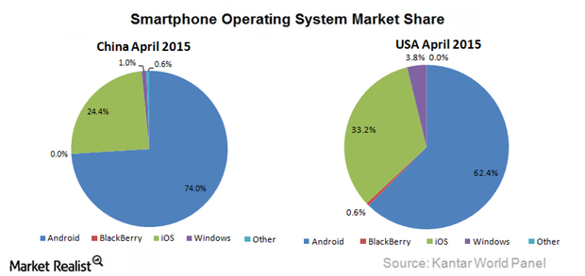
Trends in Mobile: Smartphone OS

Slide 29
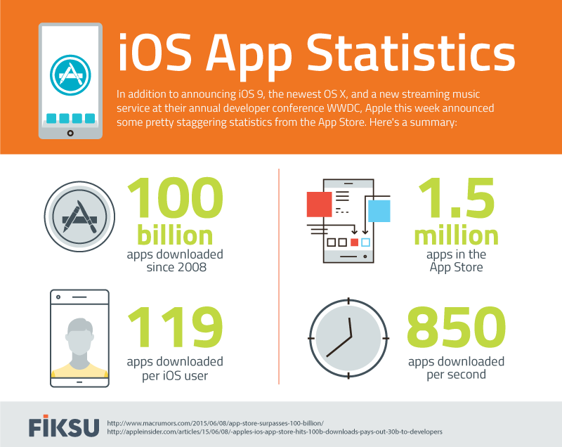
Trends in Mobile: Apps

Slide 30
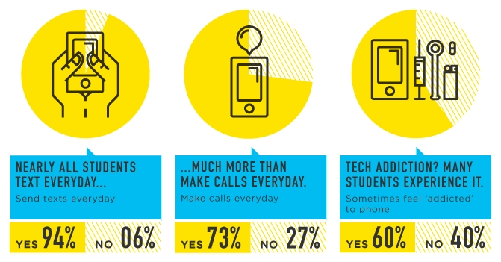
Trends in Mobile: Students

Slide 31
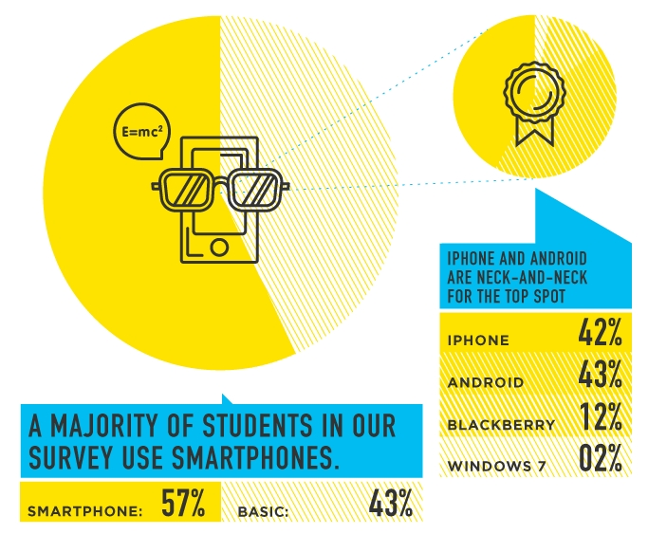
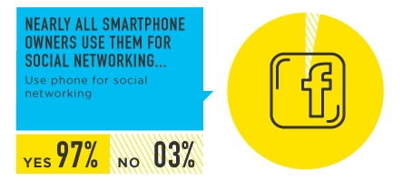
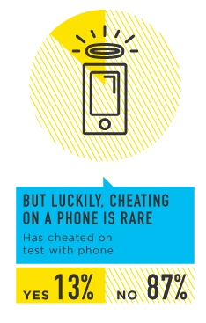
Trends in Mobile: Students

Slide 32
That’s it for today…
Questions, comments, concerns, …?
Up next: Project details/discussion/Q&A/etc. (Friday!)

